Slide 1


Sentiment Polarity Detection on Bengali Book Reviews Using Multinomial Naïve Bayes
Authors: Eftekhar Hossain, Omar Sharif and Mohammed Moshiul Hoque
Article ID-191
Presented by
Eftekhar Hossain
5th International Conference on Advanced Computing and Intelligent Engineering (ICACIE 2020)

Slide 2
Introduction
Contribution
Related Work
Proposed Approach
Results and Analysis
Conclusions
Introduction
Sentiment polarity detection is the task of assigning a review/text into a predefined sentimental category.
The task of sentiment analysis is momentous to the business community to identify the general feel of the consumers towards a product.
Determining customer impression is one of the prominent factor for the online product selling business.
Due to the rapid growth of digital contents people are more inclined on reviews before buying a particular book .
To understand a book quality a customer has to check hundreds of reviews.
5th International Conference on Advanced Computing and Intelligent Engineering (ICACIE 2020)
1/7

Slide 3
Introduction
Contribution
Related Work
Proposed Approach
Results and Analysis
Conclusions
Contribution
Develop a corpus consisting of 2000 Bengali book reviews labelled as positive and negative sentiments.
Develop a supervised machine learning model using Naive Bayes to categorize the book reviews into positive and negative sentiment .
Analyze the effect of different n-gram features on various machine learning techniques.
Analyze the performance of proposed model on various distributions of developed dataset.
Compare the performance of proposed model with the different machine learning techniques on developed dataset.
5th International Conference on Advanced Computing and Intelligent Engineering (ICACIE 2020)
2/7

Slide 4
Introduction
Contribution
Related Work
Proposed Approach
Results and Analysis
Conclusions
Related Work
Sentiment Analysis of Amazon Book Reviews (Srujan et al. [1] )
  TF-IDF with n-gram features were used for feature extraction
  and random forest classifier for classification.
Sentiment Analysis of Bengali movie reviews (Rumman et al. [2])
  Classify a movie reviews into positive an negative sentiment.
  explored support vector machine (SVM) and long short term memory (LSTM) for classification.
Sentiment analysis on Bangladesh Cricket dataset(Mahtab et al. [3])
  TF-IDF used as feature and
  support vector machine classifier used for the sentiment classification
Sentiment analysis on Bengali tweet dataset (Taher et al. [4])
  Various n-gram features were extracted from the corpus
  SVM classifier have used for the classification
As far as our knowledge, there is no study has been conducted till to date on sentiment analysis from book reviews in Bengali language.
5th International Conference on Advanced Computing and Intelligent Engineering (ICACIE 2020)
3/7

Slide 5
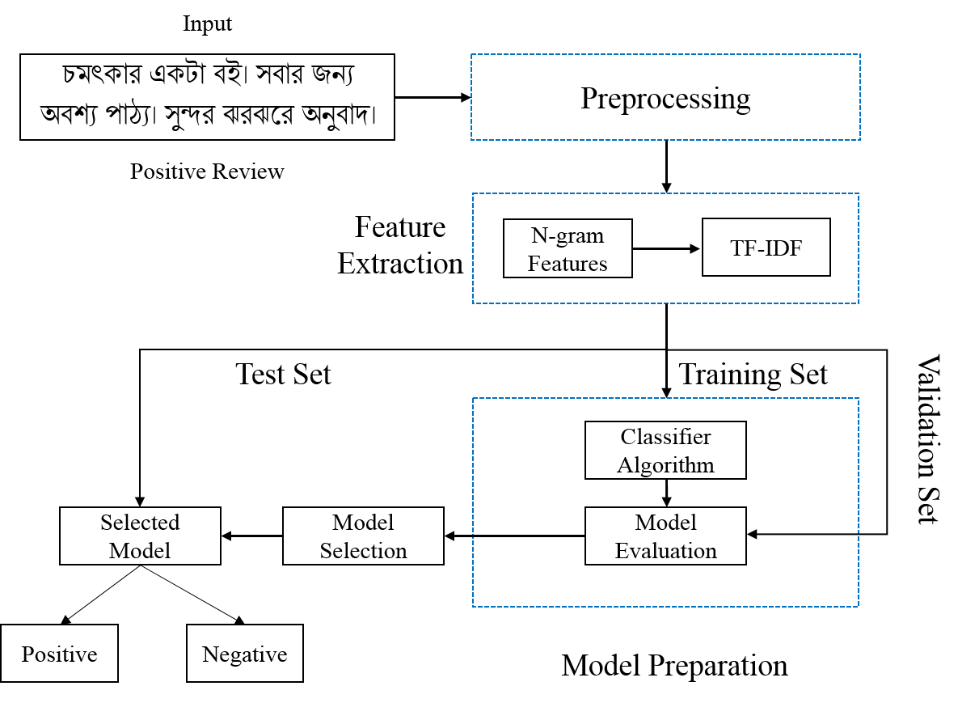
Introduction
Contribution
Related Work
Proposed Approach
Results and Analysis
Conclusions
Proposed Approach
Fig 1. Proposed Sentiment Classifier Model
5th International Conference on Advanced Computing and Intelligent Engineering (ICACIE 2020)
4/7

Slide 6
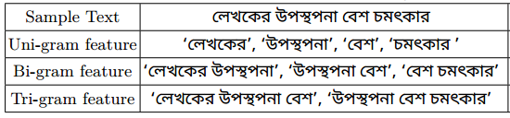
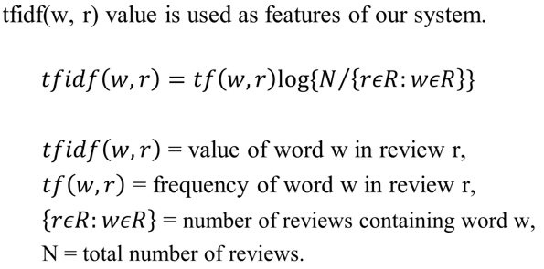
Introduction
Contribution
Related Work
Proposed Approach
Results and Analysis
Conclusions
Feature Extraction
N-Gram Feature
Table 1. Illustration of various N-grams features
TF-IDF
5th International Conference on Advanced Computing and Intelligent Engineering (ICACIE 2020)
5/7

Slide 7
Introduction
Contribution
Related Work
Proposed Approach
Results and Analysis
Conclusions
Results and Analysis
Unfortunately no benchmark dataset on restaurant reviews for the purpose of research.
Data was collected from the available web resources such as blogs, Facebook, and e-commerce sites.
We endorsed a technique of developing dataset as explained by Das et al. [5].
Dataset Attributes | Train Set | Validation Set | Test Set
Number of Documents | 1600 | 200 | 200
Number of Words | 29079 | 4458 | 5234
Total unique words | 8336 | 1193 | 1518
Number of sentences | 6728 | 1137 | 876
Table 2. Summary of the Dataset
5th International Conference on Advanced Computing and Intelligent Engineering (ICACIE 2020)
6/7

Slide 8
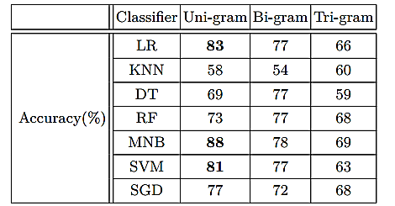
Introduction
Contribution
Related Work
Proposed Approach
Results and Analysis
Conclusions
Results and Analysis
Cross Validation
Table 3. 10-Fold Cross Validation Result
Multinomial Naive Bayes (MNB), Logistic Regression (LR), Support Vector Machine (SVM) and Stochastic Gradient Descent (SGD) have seleted for further evaluation.
5th International Conference on Advanced Computing and Intelligent Engineering (ICACIE 2020)
7/7

Slide 9
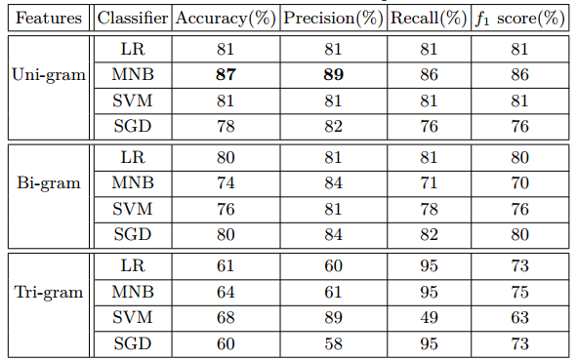
Introduction
Contribution
Related Work
Proposed Approach
Results and Analysis
Conclusions
Results and Analysis
Performance Comparison
Table 4. Performance Comparison Using Validation Set
5th International Conference on Advanced Computing and Intelligent Engineering (ICACIE 2020)
8/7

Slide 10
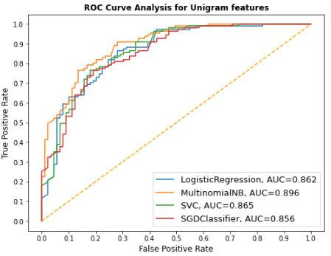
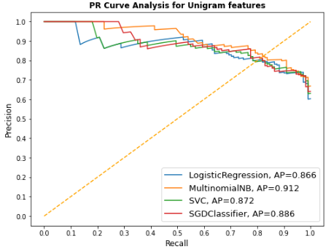
Introduction
Contribution
Related Work
Proposed Approach
Results and Analysis
Conclusions
Results and Analysis
ROC and Precision Recall Curve
In case of unigram features MNB provides highest AUC at 89.6% and average precision at 91.2%.
5th International Conference on Advanced Computing and Intelligent Engineering (ICACIE 2020)
9/7

Slide 11
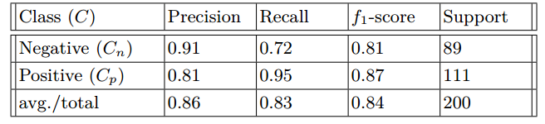
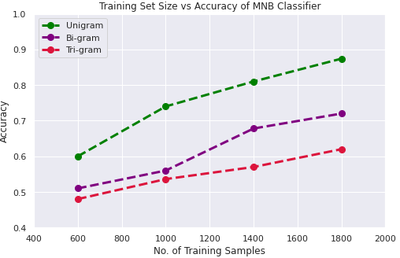
Introduction
Contribution
Related Work
Proposed Approach
Results and Analysis
Conclusions
Results and Analysis
Table 4. Proposed Classifier performance on Test Set
Figure 2 . Training Set Size impact on the performance
5th International Conference on Advanced Computing and Intelligent Engineering (ICACIE 2020)
10/7

Slide 12
Introduction
Contribution
Related Work
Proposed Approach
Results and Analysis
Conclusions
Conclusions
A system is proposed that can classify book reviews written in Bengali into positive and negative sentiment.
Various feature combinations and ML algorithms has been exploited for the system implementation.
Among these algorithms combination of Multinomial Naive Bayes with unigram features provides the highest accuracy of 87% and 84% respectively for validation and test datasets.
In future, Deep learning approach can be used to find semantic relation between words of a text for more accurate predictions.)
11/7
5th International Conference on Advanced Computing and Intelligent Engineering (ICACIE 2020)

Slide 13
Introduction
Contribution
Related Work
Proposed Approach
Results and Analysis
Conclusions
References
Srujan, K., Nikhil, S., Rao, H.R., Karthik, K., Harish, B., Kumar, H.K.: Classification of amazon book reviews based on sentiment analysis. In: Information Systems Design and Intelligent Applications, pp. 401–411. Springer (2018)
Chowdhury, R.R., Hossain, M.S., Hossain, S., Andersson, K.: Analyzing sentiment of movie reviews in bangla by applying machine learning techniques. In: International Conference on Bangla Speech and Language Processing (2019)
Mahtab, S.A., Islam, N., Rahaman, M.M.: Sentiment analysis on Bangladesh cricket with support vector machine. In: 2018 International Conference on Bangla Speech and Language Processing (ICBSLP). pp. 1–4. IEEE (2018)
Taher, S.A., Akhter, K.A., Hasan, K.A.: N-gram based sentiment mining for bangla text using support vector machine. In: 2018 International Conference on Bangla Speech and Language Processing (ICBSLP). pp. 1–5. IEEE (2018)
Dash, N.S., Ramamoorthy, Naicker, L.: Utility & application of language corpora pp. 17–34 (2019)
5th International Conference on Advanced Computing and Intelligent Engineering (ICACIE 2020)
12/7

Slide 14
Q and A?
?
5th International Conference on Advanced Computing and Intelligent Engineering (ICACIE 2020)

